Slide 1

INTRODUCTION TO
ARTIFICIAL INTELLIGENCE
PROJECT DSCI-6612-01
Team Members:
Keerthi Kappera
Kaleswara Manikanta Daddanala

Slide 2
Project Title
DISEASE PREDICTION FROM SYMPTOMS

Slide 3
Presentation outline
Introduction
Objective
Proposed System
How to Achieve this project?
Deliverables
Evaluation Methodology
Result
Conclusion
Future Work

Slide 4
Introduction
Machine Learning and Deep Learning have significantly impacted various fields, including medical science.
This dataset allows us to apply ML models to predict 42 different types of diseases based on 132 symptoms.

Slide 5
OBJECTIVE
The main objective of this project is to apply machine learning techniques to predict various diseases based on 132 symptoms. This model can assist medical professionals in diagnosing diseases and improving healthcare outcomes.

Slide 6
PROPOSED SYSTEM
Training Data
Processed
Data
Data
Transformation
Machine Learning
Algorithms
User Details
User Input
(Symptoms)
Disease Prediction Model
Predicted Result

Slide 7
HOW TO ACHIEVE THIS PROJECT?
First we collect the dataset of disease symptoms and get them into pre-processing.
Perform Exploratory Data Analysis (EDA) to understand the data.
Train the model with appropriate machine learning models
i. Decision Trees
ii. Random Forest
iii. Support Vector Machines (SVM)
Evaluate model performance using metrics
i. Accuracy
ii. Precision
iii. Recall
iv. F1-score.

Slide 8
DATA SET
Complete Dataset consists of 2 CSV files . One of them is training and other is for testing the model.
Each CSV file has 133 columns. 132 of these columns are symptoms that a person experiences and last column is the prognosis.
In the dataset, the binary values (0/1) represent the absence or presence of a particular symptom.
Example: If the Temperature column has a value of 0-No Fever, 1-Fever.
Required to train our model on training data and test it on testing data.

Slide 9
DELIVERABLES
Documentation manual mentioning about Disease prediction model implementation about various models.
Presentation on project overview.
YouTube link demonstrating the model implementation
The project will be submitted as a GitHub repository containing the following files.
  Disease Prediction from Symptoms environment code
  Machine learning algorithm code with python libraries
  Evaluation report

Slide 10
EVALUATION METHODOLOGY
Split the dataset into training and testing sets.
Train the models on the training set and evaluate their performance on the testing set.
Compare the performance of different models using metrics like accuracy, precision, recall, and F1-score.
Perform cross-validation to ensure the robustness and generalization of the models.

Slide 11
Machine Learning Models Used
The ML models used in this project are Decision Tree, Random Forest, and Support Vector Machine.
These models were chosen because they are well-suited for classification tasks.
The performance of these models depends on the quality and relevance of the features in the dataset.
In our case, we used a combination of numerical and categorical features to train the models. We also preprocessed the data by encoding the categorical features as numbers and splitting the dataset into training and testing sets. These steps helped to improve the performance of the models and ensure that they are able to accurately predict the target variable (Disease) based on the input features.

Slide 12
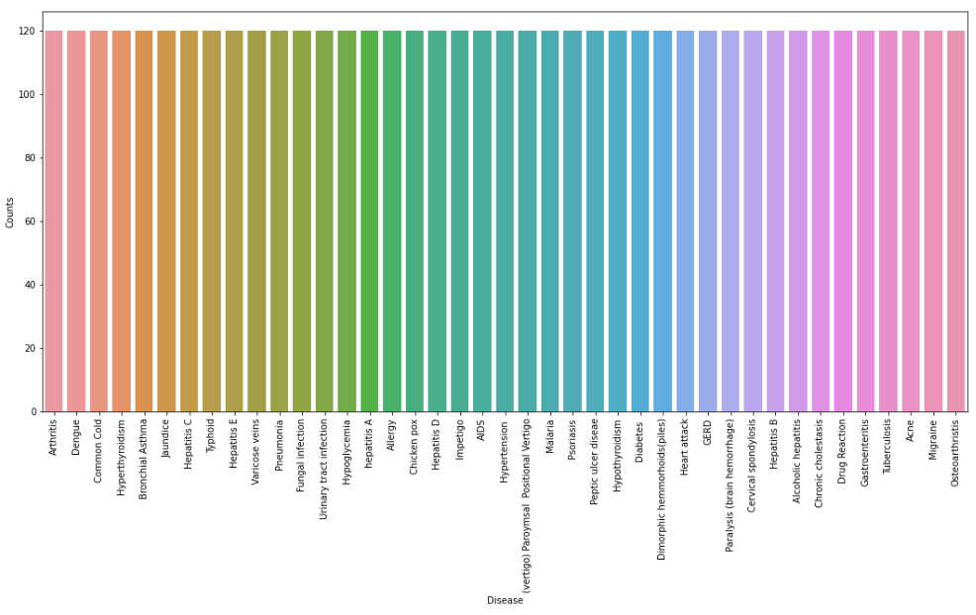
RESULT
Total number of Disease’s and their counts:

Slide 13
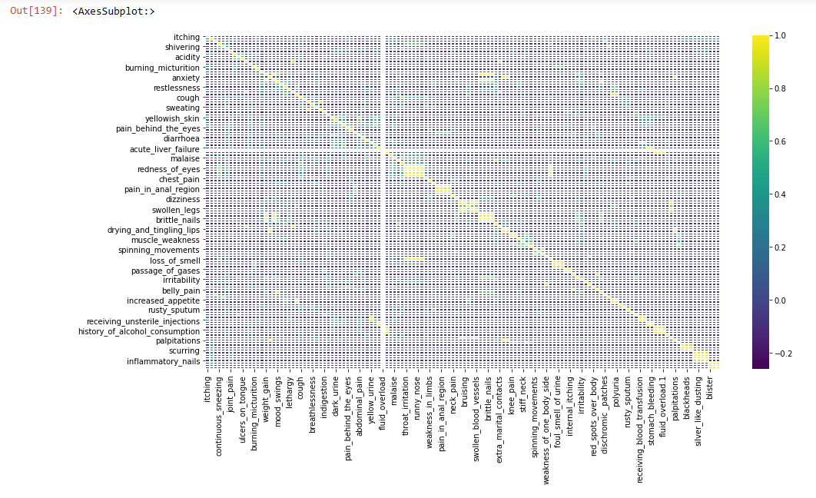
RESULT

Slide 14
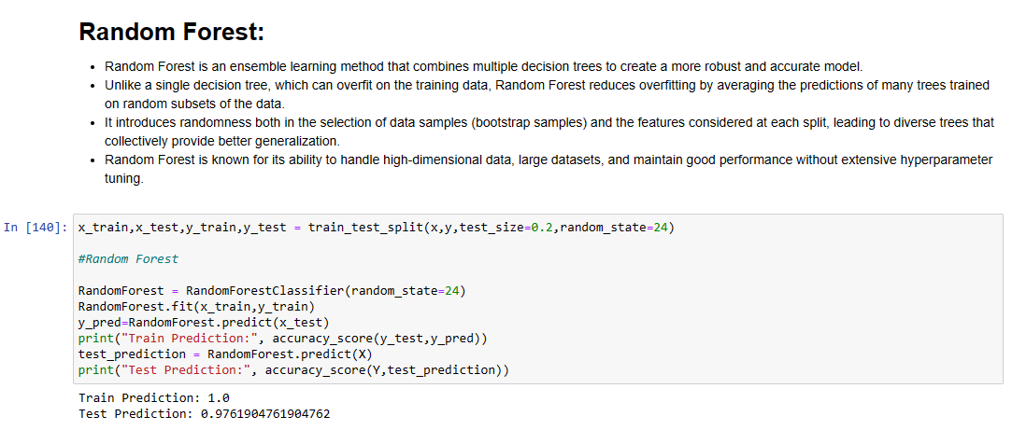
RESULT

Slide 15
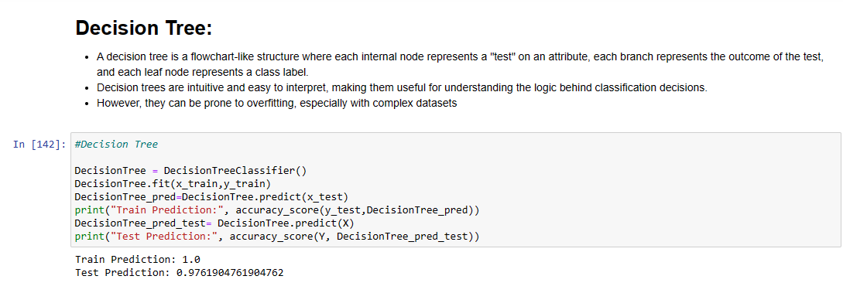
RESULT

Slide 16
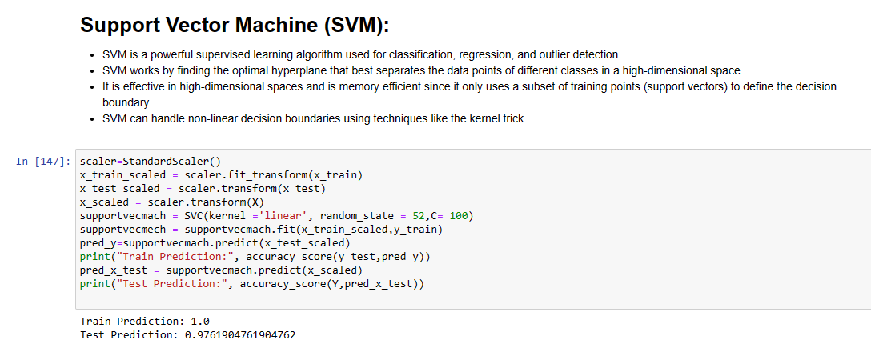
RESULT

Slide 17
CONCLUSION
The disease prediction model achieved high accuracy on the testing set, demonstrating its potential to assist medical professionals in diagnosing diseases. The model's performance can be further improved by incorporating more data, fine-tuning hyperparameters, and testing additional machine learning algorithms. Ultimately, this model can contribute to better healthcare outcomes by providing accurate and timely disease predictions.

Slide 18
FUTURE WORK
Train a model to enhance the model's ability to understand user-reported symptoms through natural language processing (NLP) techniques.
Train the model to interpret various ways users might describe their symptoms.

Slide 19

Thank You

